Slide 1
Rockbuster Stealth: Data Analysis Project
Zahid Niloy

Slide 2
Introduction
Facing intense competition from streaming giants like Netflix and Amazon Prime, the management team at Rockbuster Stealth is gearing up to launch an online video rental service using its existing movie licenses to remain competitive. Under the guidance of the business intelligence (BI) department, this analysis has been conducted to support the launch strategy for the new service. It addresses critical questions posed by management regarding revenue contributions from various movies, customer demographics, and sales performance by region. By leveraging these insights, Rockbuster aims to tailor its offerings and marketing strategies effectively, ensuring a successful entry into the digital rental market.

Slide 3
Business Questions to Address
Board with regards to their evolving strategy for 2020:
● Which movies contributed the most/least to revenue gain?
● What was the average rental duration for all videos?
● Which countries are Rockbuster customers based in?
● Where are customers with a high lifetime value based?
● Do sales figures vary between geographic regions?

Slide 4
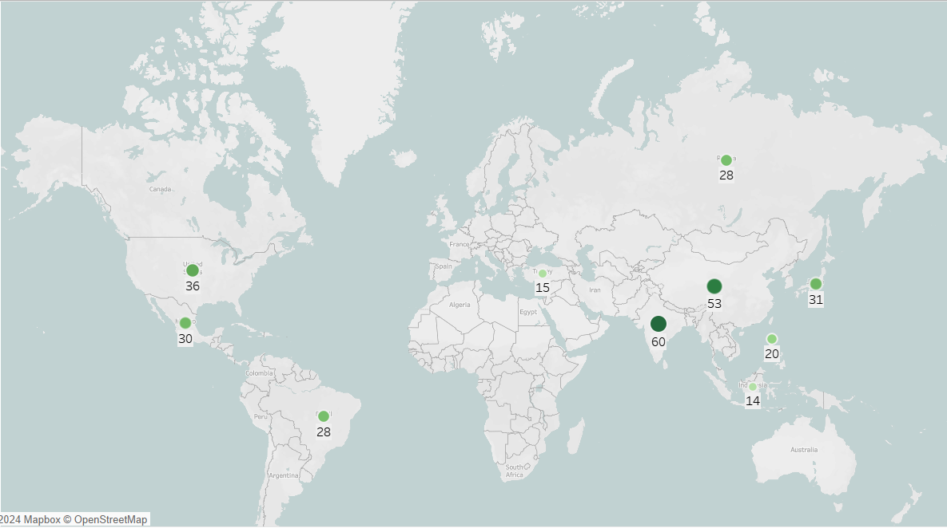
Our top 10 countries are quite revealing - it ranks markets by both revenue and customer volume, highlighting where we should focus our efforts. With such a concentration of users in these areas, we've got a real opportunity to boost engagement through smart, regionalized promotions.
India, China, the USA, and Japan are the heavyweight champions, commanding 57% of total sales. These markets are prime targets for our new streaming platform's marketing strategy.
Don't overlook the promising contenders, though. Mexico, Russia, and Brazil are showing some serious potential and could benefit from customized promotional approaches.

Slide 5
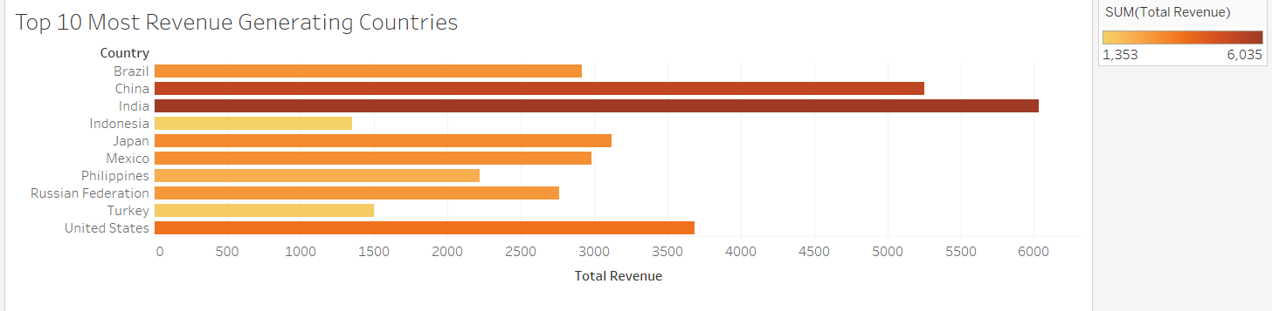
Key Observations:
India appears to be the top revenue-generating country with the longest bar.
China and the United States also show significant revenue contributions.
Countries like Indonesia and Turkey have relatively shorter bars, indicating lower revenue generation compared to the top performers.

Slide 6
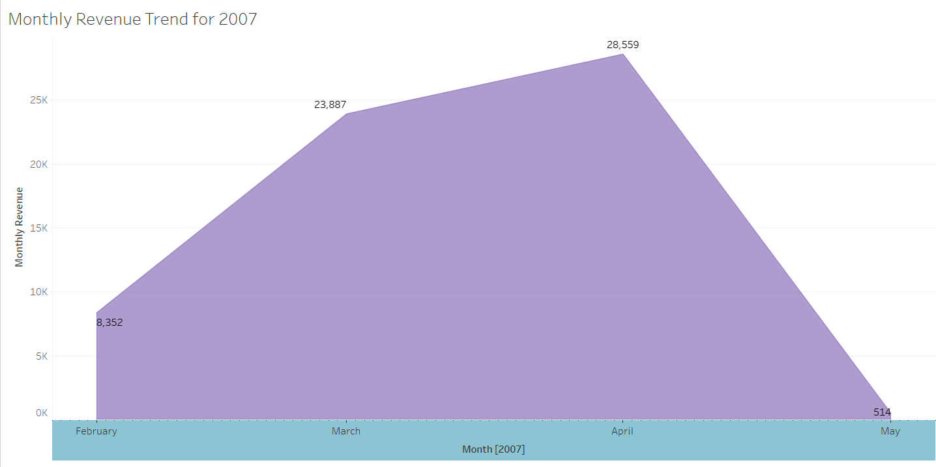
The graph suggests a seasonal pattern or a one-time event contributing to the high revenue in April
Overall trend indicates a significant positive revenue growth until April followed by a dramatic decrease

Slide 7
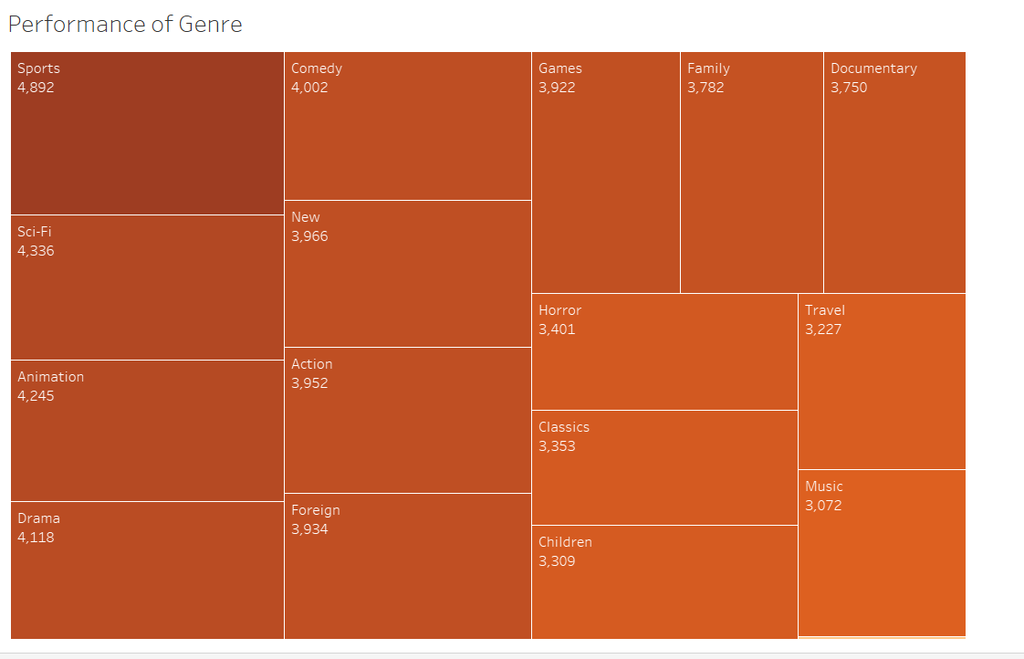
Sports appears to be the most popular genre with the largest area in the diagram.
Comedy and Games also rank high in terms of performance.
Genres like Music, Travel, and Children have smaller areas, suggesting lower viewership or engagement compared to the top genres.
The diagram provides a quick visual comparison of the relative performance of various genres.

Slide 8

Recommendations
Investigate the factors contributing to the high revenue in April. Was it a promotional campaign, a new product launch, or a seasonal event?
Analyze the reasons for the steep decline in May. Were there unforeseen circumstances, a change in market conditions, or a shift in consumer behavior?
Consider implementing strategies to maintain revenue momentum beyond the peak season. This could involve targeted marketing campaigns, customer retention programs, or exploring new revenue streams.
To cut down on expenses related to movie licenses, think about discontinuing titles that have little to no rental history.

Slide 9
Thank You!

